Slide 1


Git and GitHub Course

Slide 2
What is Git?
What is GitHub?

Slide 3
Git and GitHub
Git is a local machine source code version control system. Both Git and GitHub are free and open source. Although originally independent, GitHub is now owned by Microsoft.
GitHub is a remote web based centralized source code version control repository system for storing Git source code in the cloud. As previously stated, Microsoft now owns GitHub, but makes it freely available for all developers to use freely worldwide.
Git makes GitHub de-centralized by allowing GitHub centralized source code to be de-centralized on developer’s machines around the world.

Slide 4
Since Git and GitHub are two different products, Git will be covered in the first part of this course, Part A, whereas GitHub will be covered in the second part of this course, Part B.
GitHub will be covered in Part B of this course.

Slide 5

So, what does Git mean and where did the Git system originate?
Linus Torvalds the originator of the Linux Operating System Kernel, as a student in Finland, decided to Open Source the Linux Kernel to developers on the web so they could begin the process of contributing to the continued development of the Linux Kernel.
Linus soon realized he needed a centralized source control system so developers could input their source code for review and inclusion into the Linux Kernel development.
As a result of this need, Linus developed both Git and GitHub as a distributed source control system which developers could used to submit changes and upgrades to the Linux Kernel. Although, GitHub is a centralized source control system, Git akes it a de-centralized source control system because each developer has their own copy of the Kernel on their machine.
So what does Git mean, not much, Linus used some English Slang where “git” means and “unpleasant person” as a name. We can only just speculate as to why Linus chose this name.
Linus Torvalds

Slide 6
Part A, the Git Distributed Source Control System.

Slide 7
Git is a localized source control system, that can be used with or without GitHub.
Using Git with GitHub provides several advantages:
Using GitHub with Git, allows others to access your source code.
Using GitHub with Git, provides for developer collaboration on projects.
Using GitHub with Git, provides a remote back up of local source code.
GitHub is the most widely used Source Control system in the world.
Remember: This section, Part A, of the course only focuses on Git, whereas GitHub will be covered later in the course under, Part B.

Slide 8
How to install Git?
If you have a Mac or a Linux system, then Git may already be installed.
So, how do I install Git on a Windows Operating System?
Go to the following URL in your browser: https://git-scm.com/download
You will see the Git Download web screen as shown on the next slide…

Slide 9
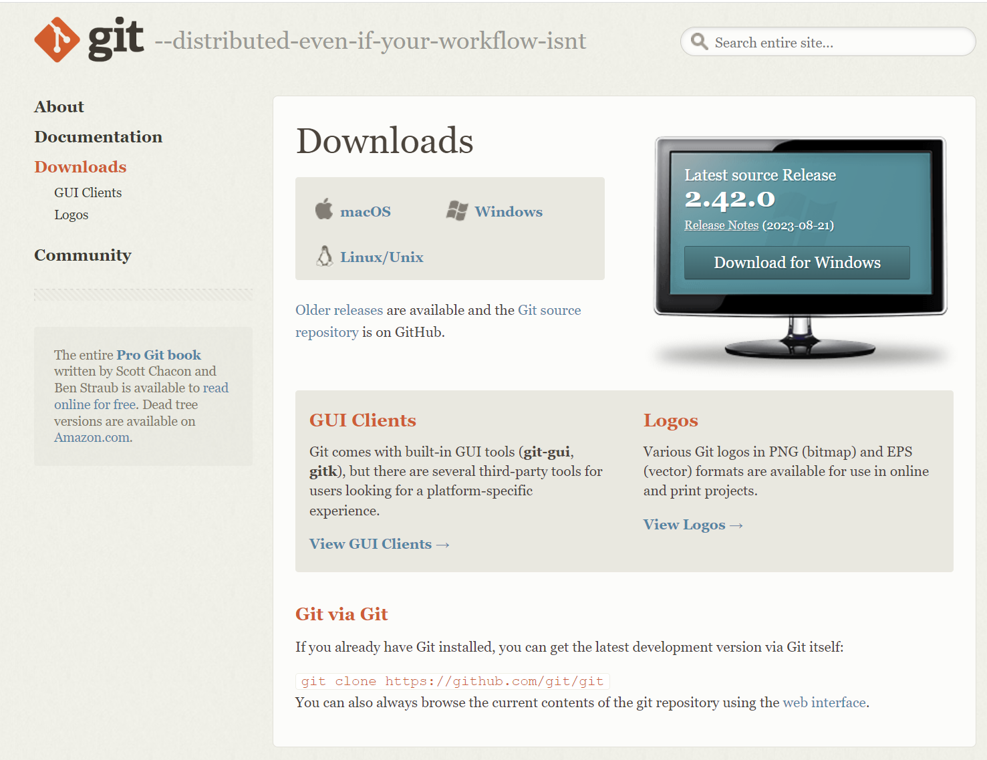
Git download page… https://git-scm.com/download
Click on Windows and follow the installation instructions.

Slide 10
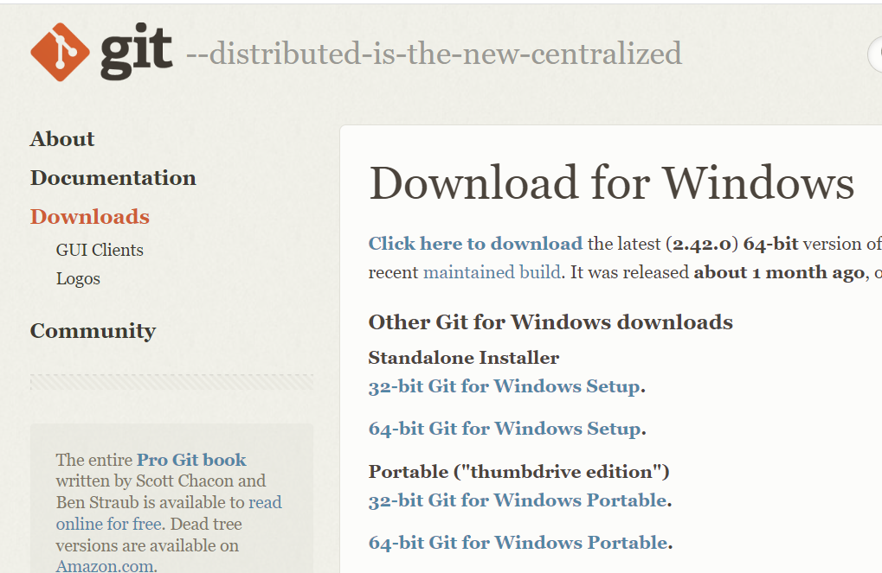
Git download for Windows
Most newer Windows OSes are 64 bit, select 64-bit to start the download.

Slide 11
Git installation on Windows…
A Git installation file will be downloaded to your Windows computer.
It must likely will be downloaded to your Windows downloads folder.
If it is downloaded somewhere else, you will have to find it and run it.
Select all the default options to complete the Windows Git installation.

Slide 12
You are now ready to begin using Git with Windows…
First we need to go to the Command Prompt and verify the Git installation.
If you are someone who has never used the Command Prompt in either Windows or Unix/Linux then this will be a new learning experience for you.
Seasoned, experienced programmers and technicians are used to the command line.
There are GUI (Graphical) Tools for Git, but these are not recommended for learning Git initially, once Git Command Line is mastered it is then ok to use a GUI Git Tool.
The next slide will show you how to bring up a Windows Command Prompt and verify that Git has been installed successfully.

Slide 13

Bring up a Windows Command Prompt to Verify the Git Installation…
Go to the windows in the lower left hand corner of your Windows screen as shown:
Type cmd in this window, then press the Enter key.

Slide 14
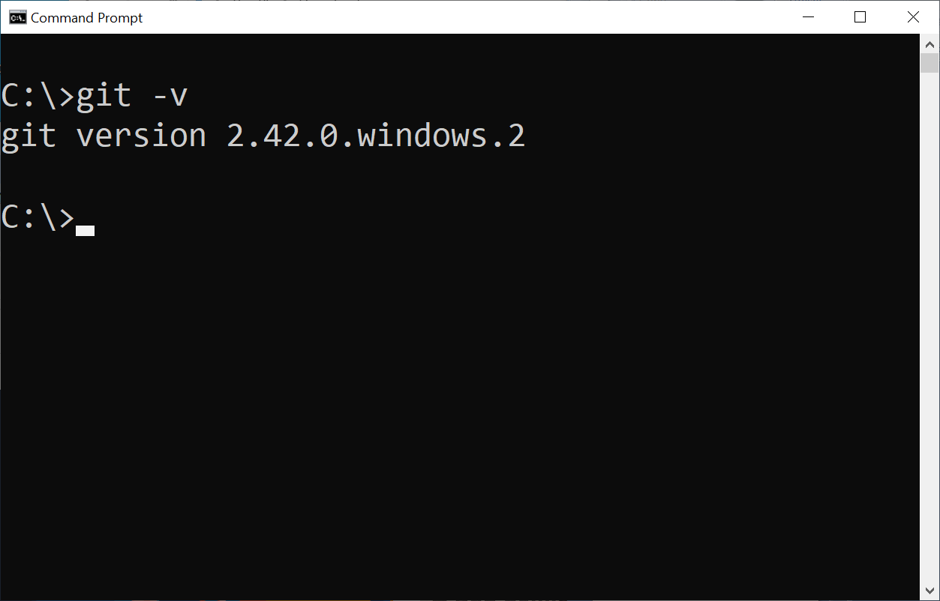
In the Command Prompt, type “git –v” as shown in the screen shot below:

Slide 15
Now you need to identify yourself to Git…
Provide your profile information to Git as follows…
> git config --global user.name “John Doe“
git config --global user.email jdoe@gmail.com
git config --global core.editor notepad

Slide 16
Now, you are ready to begin using Git.
But, what does it take to begin using Git?
You must create a Git Repository in a Windows directory (Folder).
Unix and Linux use the term “directory”, whereas Windows calls them “folders”.
These are completely interchangeable terms, use whichever you prefer.
You do this by navigating (moving) to a specific folder and creating a Git Repository.
Again, if you are not savvy about using the command line, you have much to learn.

Slide 17
You will now create a Windows folder and turn it into a Git Repository:
Best place to create Git Repositories is probably under your user Desktop folder.
First, you will create a folder on your Desktop called “repos”…
First you will move to your home directory in Windows.
At Command Prompt, enter “cd \users”, this will take you to the “users” directory.
If you type “c>\users> dir” it will show the name of your home directory.
Type “C:\users> cd yourusername” to get to your home directory. Use your username.
You now want to move to your Desktop folder.
Type “C:\users\yourusername> cd Desktop”, to move to your Desktop folder.
Type “C\users\yourusername\Desktop> mkdir repos”, to create a repos folder.
Type “C:\users\yourusername\Desktop\repos> mkdir repo1”, to create a directory
Type “C:\users\yourusername\Desktop\repos> cdr repo1”, to create a repo directory.
Type “C:\users\yourusername\Desktop\repos\repo1> git init”, to create a Git Repository. Note: You normally would use your project or web site name.

Slide 18
What does it really mean to create a Git Repository in a Windows directory?
When “git init” is run in a Windows folder, it creates a Git Repository in that folder.
There is a hidden folder called .git that is managed by Git to control your source code.
Once you have created a Git Repository you can begin using Git Source Control Commands.

Slide 19
Remember!
Git is Local
Using Git Source Control commands in a Windows Git Repository directory:
There are three (3) logical parts to Git repositories. All three parts are located in a Git Repository Folder as shown here:
Managed by Git
Edit Files Here
Working
Area
(Not Git
Managed)
Staging
(Index)
Area
Local
Repository
Area
Add
Commit
Git Repo Directory

Slide 20
Remember!
Git is a Local
Repository.
As you can see from the previous slide, files you create in your Git Repo Directory go into the Git Repo Working Area as un-managed files with no source control.
You have to issue the Git Add and Git Commit to place files under source control.
Edit Files Here
You edit and save all your program
source files or any other text or
Word files you wish to save in you
Git Repo Directory Working Area.
Note: Most often Git is used for
Program Development source files.
Edit
Working
Area
(Not Git
Managed)
Git Source
Control
Save
Example: C:\users\yourusername\Desktop\repos\repo1

Slide 21
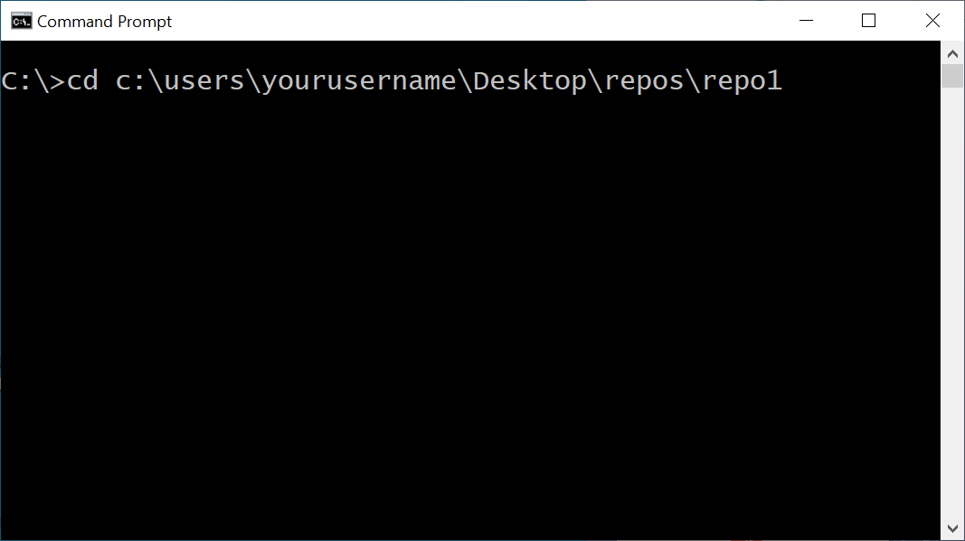
Remember!
Git is a Local
Repository.
You will now create a couple to test files to be placed under Git control later on…
Open up your Command Prompt and make sure you are in the correct repo directory..
Type the following…
echo file1 > file1.txt
echo file2 > file2.txt
dir
These two files should show up in your repo directory.

Slide 22
Remember!
Git is a Local
Repository.
You are ready to copy these files from Working Area to Staging Area under Git Control.
Type the following…
git add .
You have just copied your work files to the Staging Area.
Type the following…
git status
You files are now being tracked by Git in Staging , but are not fully under Git Source Control, there is one more step.

Slide 23
Remember!
Git is a Local
Repository.
You are ready to move your files from the Git Staging Area to the Git Repository Area.
Type the following…
git commit –m “Initial Commit”
git status
You have just moved your stage files to the Git Repository.
You files are now under total Git Source Control.
The –m message for Commit is mandatory and important.
Future Commit messages should describe your commits.

Slide 24
Remember!
Git is Local
Now let us review the steps taken to ultimately commit files to Git source control
Step 1: You created a couple of source files In the Working Area. Step 2. You added (copied) your files to the Staging area with the > git add . Command. Step 3. You moved your Staged files to the Git Repository with the > git commit –m msg
Managed by Git
Edit Files Here
Working
Area
(Not Git
Managed)
Staging
(Index)
Area
Local
Repository
Area
Add
Commit
Git Repo Directory

Slide 25
Remember!
Git is Local
Congratulations! You are now a Git user, but you need to know more…
How do you see what is in your local Git Respository for the repo1 Git folder repo?
Type > git branch You see a * next to master, which means you are on the main branch. Additional branches are not necessary for local Git Repositories.
Managed by Git
Edit Files Here
Working
Area
(Not Git
Managed)
Staging
(Index)
Area
Local
Repository
Area
Add
Commit
Git Repo Directory

Slide 26
Remember!
Git is Local
To see the snapshots (Commits) enter the “>git log” command.
You see only that the HEAD of the Git tree points to master branch, only one branch.
If you do a second Commit you will add another snapshot to the master branch.
Managed by Git
Edit Files Here
Working
Area
(Not Git
Managed)
Staging
(Index)
Area
Local
Repository
Area
Add
Commit
Git Repo Directory

Slide 27
Remember!
Git is a Local
Repository.
You are now ready to add a second snapshot to the master Git branch.
Add a third file to your working area: > echo file3 > file3.txt then add/commit below.
Type the following…
> git add file3.txt
git commit –m “Second Commit”
git status
git log
You have just moved your stage files to the Git Repository.
You files are now under total Git Source Control.
The –m message for Commit is mandatory and important.
Future Commit messages should describe your commits.

Slide 28
Remember!
Git is Local
You see the snapshots (saved versions) with the “>git log” command.
You see only that the HEAD of the Git tree points to master branch, only one branch.
You did a second Commit so you will add another snapshot to the master branch.
Managed by Git
Edit Files Here
Working
Area
(Not Git
Managed)
Staging
(Index)
Area
Local
Repository
Area
Add
Commit
Git Repo Directory

Slide 29
Remember!
Git is Local
This is great, but how do I access these various snapshot on the master (main) branch?
In the >git log display you will see a very long hash value next to each commit (snapshot).
Each Commit Hash Value will be different, copy from >git log, to use with your checkout.
Managed by Git
Edit Files Here
Working
Area
(Not Git
Managed)
Staging
(Index)
Area
Local
Repository
Area
Add
Commit
Git Repo Directory

Slide 30
Remember!
Git is a Local
Repository.
I will now demostrate how to checkout a previous commit snapshot in master branch,
Remember, you commit hash value will be different from mine, so copy your hash.
Type the following…
git log
commit e13fad8840b8c3ab03d4d529ed460609a082ed2f (HEAD -> master)
Author: Brad Brodge <bradtron2000@yahoo.com>
Date: Sun Oct 1 15:05:41 2023 -0400
second commit
commit 0ab4f9aeef47b928e1fd4f1db4dc173967be92e5
Author: Brad Brodge <bradtron2000@yahoo.com>
Date: Sun Oct 1 14:31:32 2023 -0400
initial commit
I am going to use the hash from my initial commit as my snapshot hash value.

Slide 31
Remember!
Git is a Local
Repository.
I will now demostrate how to checkout a previous commit snapshot in master branch,
Remember, you commit hash value will be different from mine, so copy your hash.
Type the following…
git checkout e13fad8840b8c3ab03d4d529ed460609a082ed2f
Note: switching to 'e13fad8840b8c3ab03d4d529ed460609a082ed2f'.
Note: There is additional information displayed that you should read and review that outputs to the command prompt.
I am going to use the hash from my initial commit as my snapshot hash value.

Slide 32
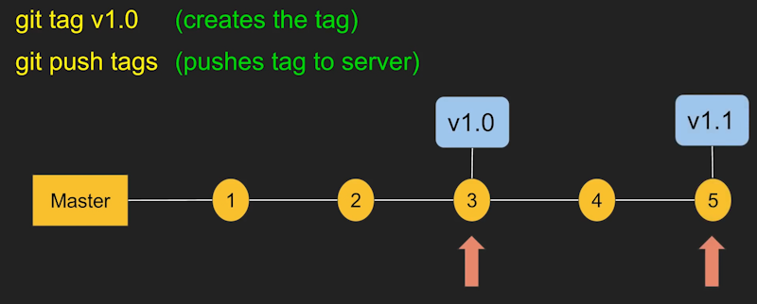
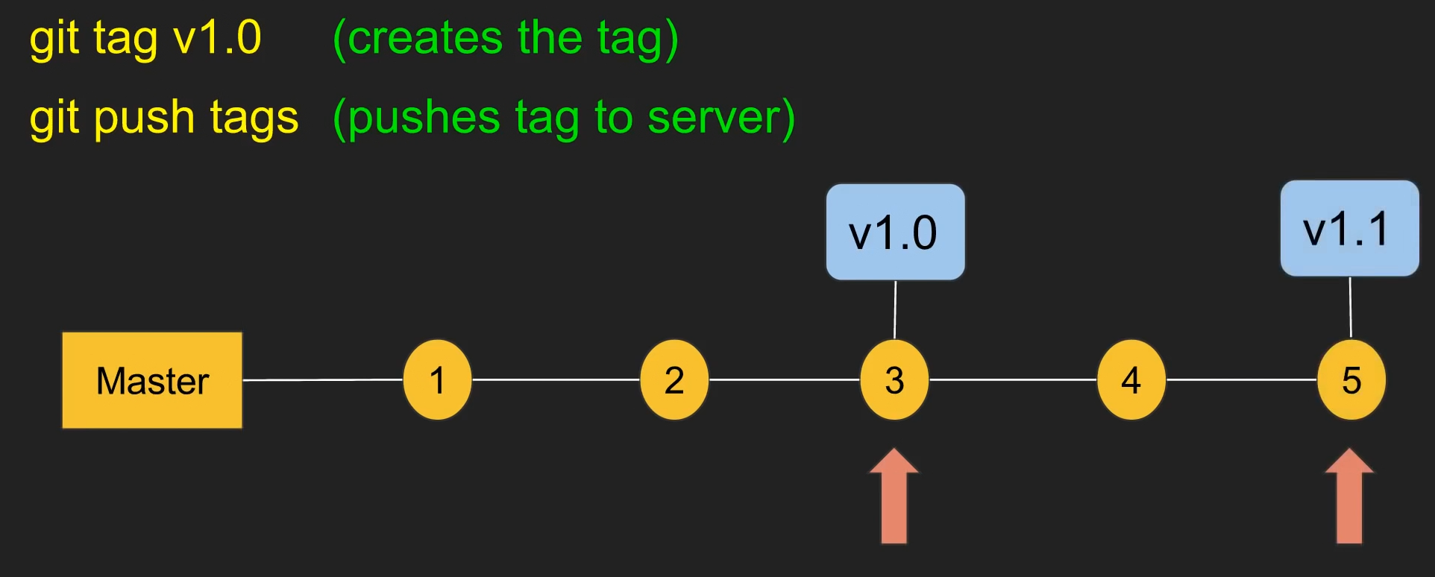
Remember!
Git is a Local
Repository.
Below is an example of how you would use Commit Tags to identify specific Snapshots.
As you can see, you only have to place tags on certain commits and not on others.

Slide 33
Remember!
Git is a Local
Repository.
In a previous slide you saw the difficult way to checkout a previous commit snapshot.
But, there is an easier way by identifying your commit snapshots with Tag IDs..
Type this after doing a version Commit…
git tag v1.0
You have just placed a version tag in your git history.
You now have a tag on the last commit you executed.
You can now retrieve the tagged code using its tag…
>git checkout tag/v1.0
This should checkout v1.0 of the master code branch.
Using the Commit Snapshot Version Tab ID is the better way to manage versions.

Slide 34
Remember!
Git is a Local
Repository.
Git Branches will be discussed in Part B of this course covering GitHub and branching.
Local Git repositories that do not use GitHub usually do not need to use branches.
Type the following…
git branch branch-a
This creates a new branch called branch-a from master.
To check this branch out, type the following…
git checkout branch-a
So you see creating and checking out branches is much easier than checking out a commit snapshot on a branch.
Branches will be revistied in Part B of this course, when GitHub is covered.

Slide 35
Remember!
Git is Local
This is the end of the Git Part A of the NCI Git / GitHub course.
Hope you have a handle on Git as we proceed into GitHub.
Managed by Git
Edit Files Here
Working
Area
(Not Git
Managed)
Staging
(Index)
Area
Local
Repository
Area
Add
Commit
Git Repo Directory

